Slide 1
About Me
Ms. Marwa Khan
Email-ID: Marwa.khan@nu.edu.pk
Class Timings: 1:00pm – 4:00pm
Grading: Absolute
Attendance: 80%
Google classroom Code: clsarmp

Slide 2
Introduction to ICT Lecture 01

Slide 3
Course Outline & Marks Distribution
Week | Topic
1 | Introduction
2 | Number System
3 | Computer Organization
4 | Mathematics in Computer Science
5 | Operating systems
6 | Data Management and its applications
7 | Computer Graphics
8 | Communication
9 | Web development
10 | Artificial Intelligence
11 | Big data
12, 13, 14 | Student Presentations
 | FINAL EXAM
Class Participation, Assignments & Quizzes | 25%
Final Presentation | 25%
Exam | 50%

Slide 4
Introduction to Information and Communication Technology (IICT)
What is IICT?
Significance of IICT
Why we need to study this course?
Looking into the impact of Computers in our lives.

Slide 5
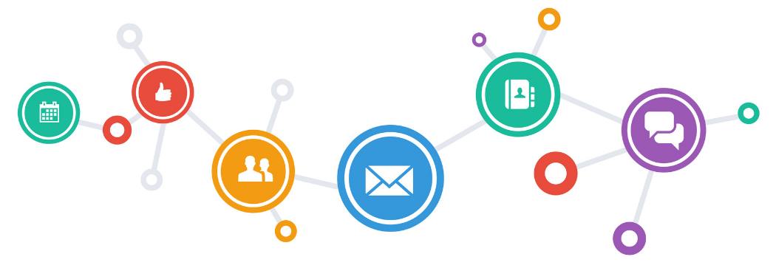
ICT
Information
Any entity or form that provides the answer to a Query
Communication
Act of transferring information from one place to another
Technology
Collection of techniques, methods and processes used to produce goods or services or accomplish objectives.

Slide 6
The Meaning of ICT
Information
Communication
Technologies
ICT are the hardware and software that enable society to create, collect, consolidate and communicate information in different formats and for various purposes.

Slide 7

Do you use an ICT

Slide 8
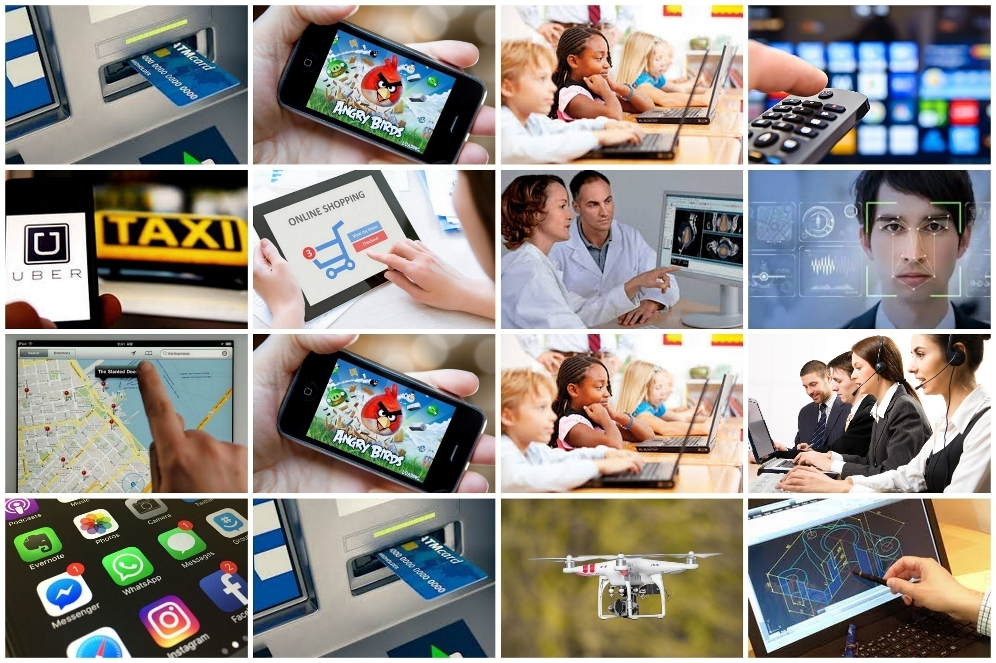

Slide 9
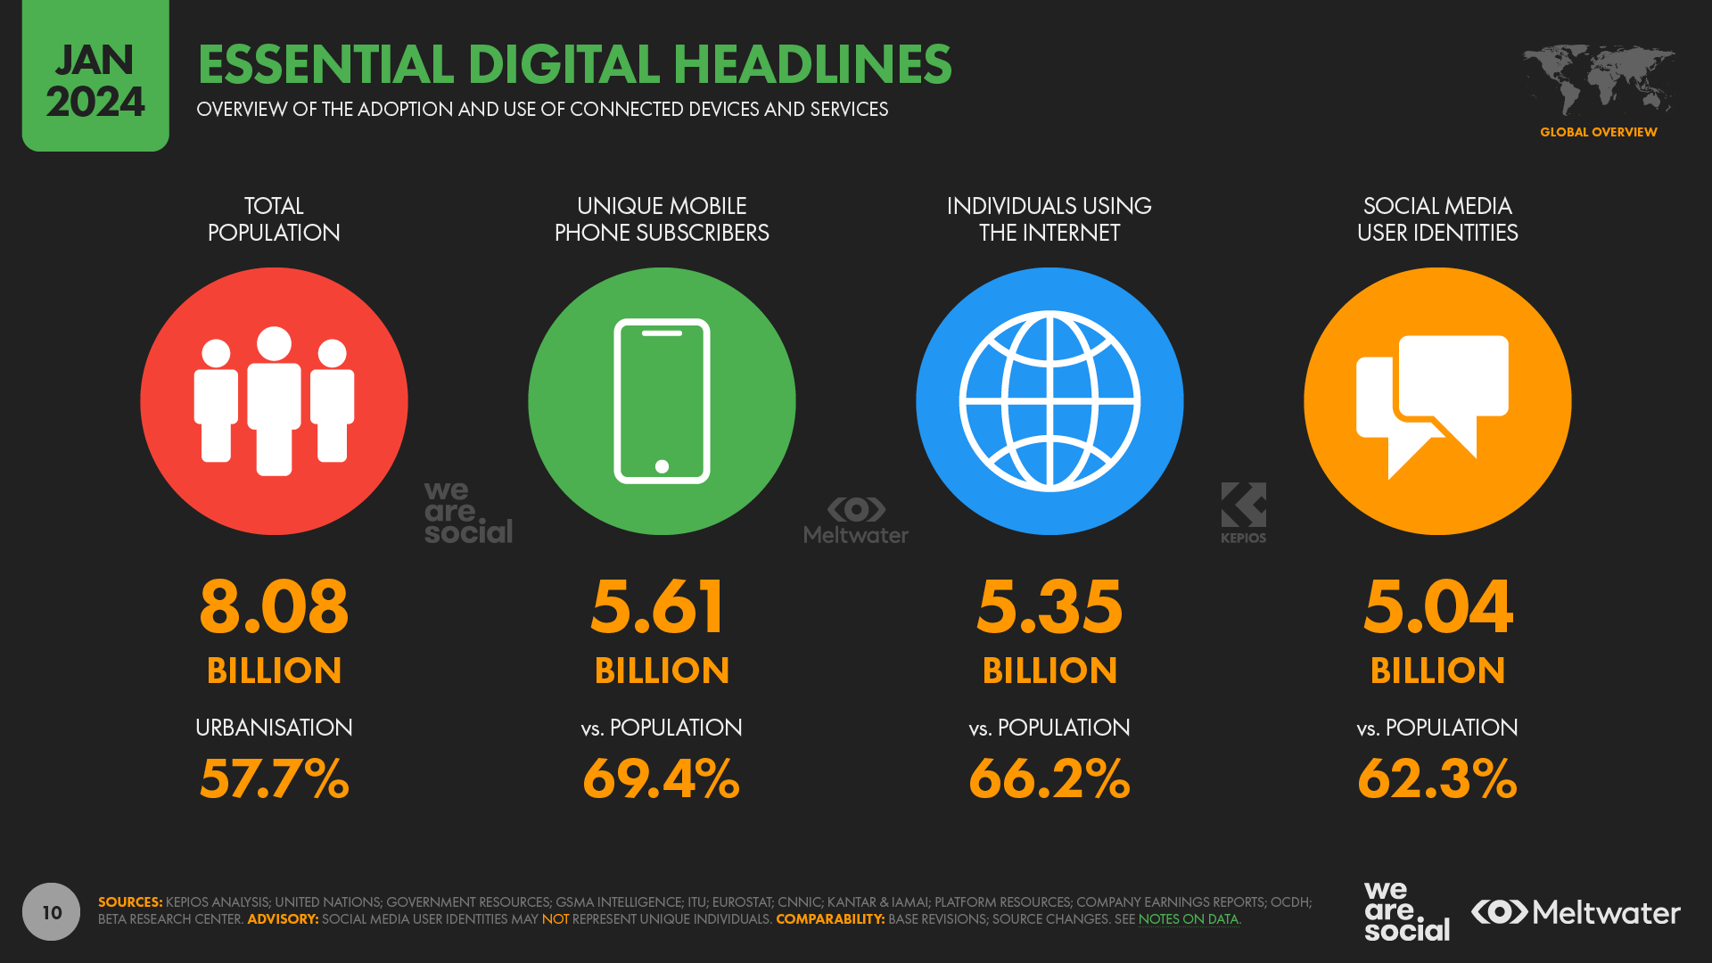
Amazing Facts and Statistics

Slide 10
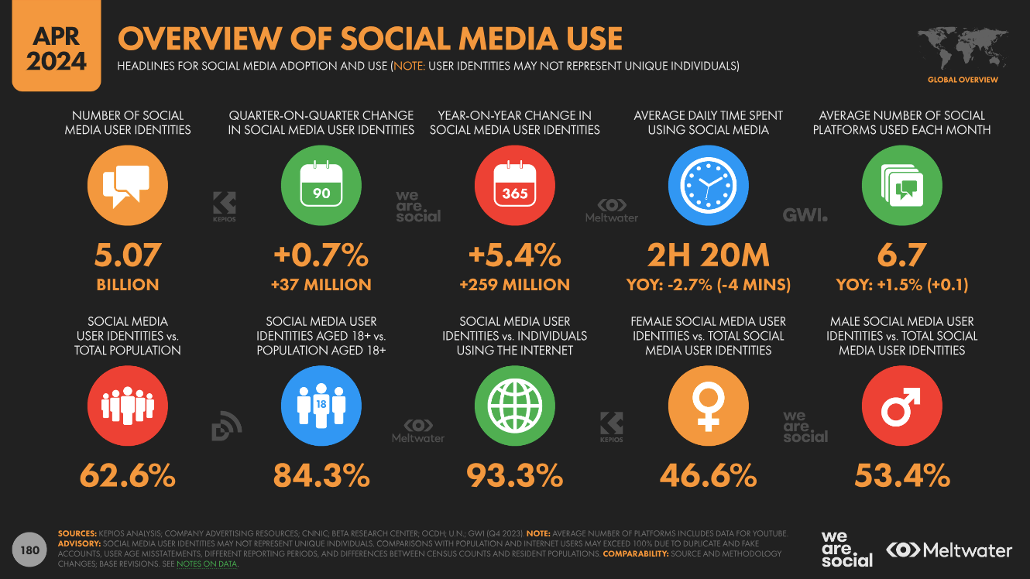
Amazing Facts and Statistics

Slide 11
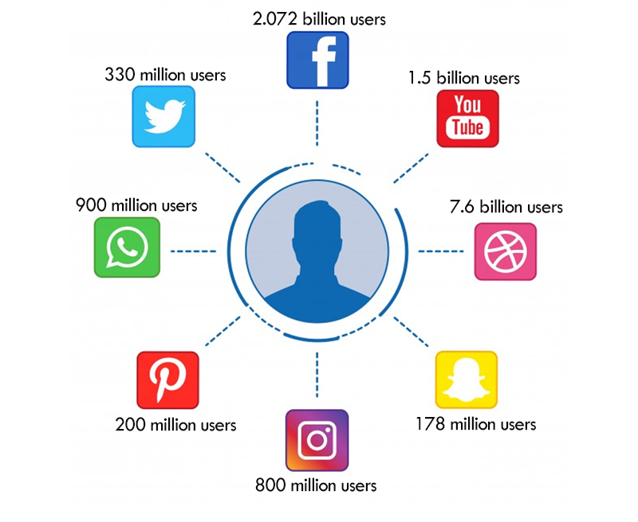
Amazing Facts and Statistics

Slide 12
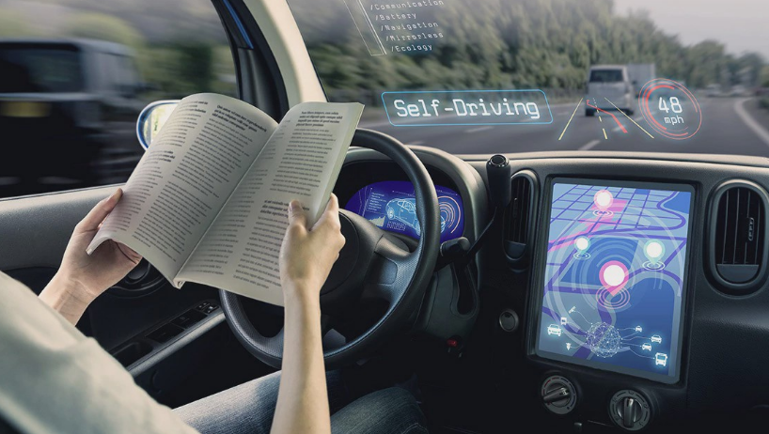
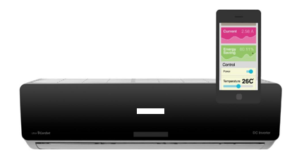
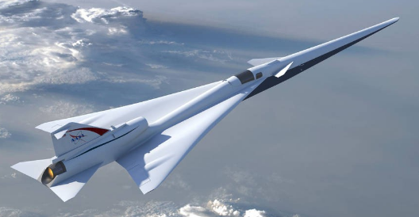
Cont…
Computers are penetrating into every aspects of our lives
Air Conditioners
Cars
Airplanes
Smartphones
Etc…
Notes:
Any other example in your mind

Slide 13
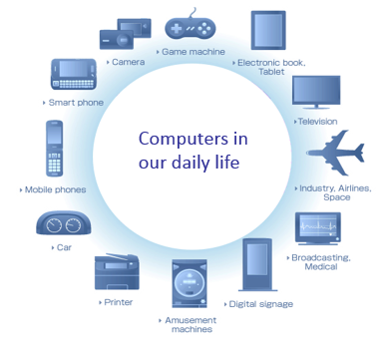
So, these computers are taking over our lives.
Is this good or bad?
Some examples of Computers (Embedded Systems) in our daily life

Slide 14
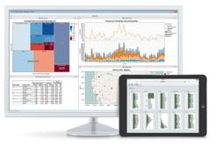
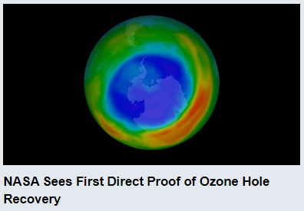
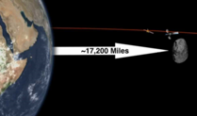

Bright side of Computer
Enable new discoveries
Lead to efficiencies
Making Life easy

Slide 15
Making Life Easy
Today, computers are used in every/most of the aspects of our lives.
Some aspects are given below:
Social Media/Communication
E-Commerce/ M-commerce
Automation
Defense
Education and Science & Technology
Recreational Aspects

Slide 16
Transition
Shift from Print to Digital
Internet
Innovations in ICT have made the transfer of digital information from remote sites possible

Slide 17




Social Media/Communication
Some examples of Social Media
Facebook
Twitter
LinkedIn
Facebook Messenger
WhatsApp
…

Slide 18



E-Commerce
Amazon
Daraz.pk
UBER
Air/Bus ticket booking and seat reservation

Slide 19
Automation
Home automation system
Example: JARVIS by FACEBOOK
Car assembly automation
Food products packing

Slide 20
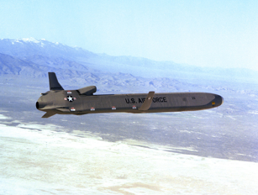
Defense/Military
Missile Control
Military Communication
Military Operation and Planning
Smart Weapons

Slide 21

Education
Education
The computer provides a tool in the education system known as CBE (Computer Based Education).
CBE involves control, delivery, and evaluation of learning.
Computer education is rapidly increasing the graph of number of computer students.
There are a number of methods in which educational institutions can use a computer to educate the students.
It is used to prepare a database about performance of a student and analysis is carried out on this basis.
Notes:
Yes As I am delivering lecture using computer, FAST Uni online test. Flex system, attendance management and evaluation etc.

Slide 22
Recreational and Entertainment Aspect
Some examples?
Animated Movies
High graphics games

Slide 23
Basics
Computer
Hardware
Software
CPU
Memory
I/O
Application
Software
System
Software

Slide 24
Hardware: Processor
Processor consists of 2 components: ALU & CU
The control unit (CU) of the CPU contains circuitry that uses electrical signals to direct the entire computer system to carry out, or execute, stored program instructions.
The arithmetic/logic unit (ALU) contains the electronic circuitry that executes all arithmetic and logical operations.

Slide 25
Hardware: Memory
Primary Memory
RAM, SRAM, DRAM, SDRAM
ROM, EROM, EPROM, EEPROM
Secondary Memory
CD, DVD, Memory Cards
SD Cards, Flash Drives

Slide 26
Hardware & Software
Hardware | Software
Physical elements of a computer or electronic system | A collection of instructions that tells the computer how to perform a task
Categories: I/O devices, Processor, Memory | Mainly divided into system software and application software
Tangible | Intangible
Developed using electronic and other materials | Developed by writing instructions using programming languages
When damages, it can be replaced with a new component | When damages, it can be reinstalled using a backup copy
Starts functioning once the software is loaded into the system | Should be installed into the computer to function
Examples: Keyboard, Mouse, CPU, ROM, RAM | Examples: MS Word, Excel, Whatsapp, Instagram

Slide 27
System Vs Application (Software)
System Software | Application Software
System software controls hardware. | Application software fulfils user requests
Acts as an interface between hardware and application software | Runs on the platform provided by system software
Examples include, Operating Systems, device drivers, etc. | Word processors, media players, etc.

Slide 28
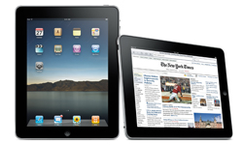
Types of Computer
PC (Personal Computer )
Small
Inexpensive
Business Use
Word processing, running spreadsheets etc.
Personal Use
Playing games, surfing the internet, movies, games etc.
Single user system

Slide 29
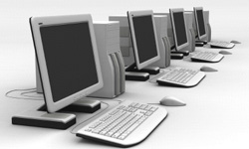
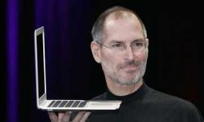
Types of Computer
Desktop
PC not designed for portability
More storage and computation with less cost
Laptop (notebook)
Portable with integrated display
Battery operated

Slide 30
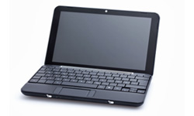
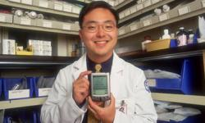
Types of Computer
Netbook/Notebook
Smaller and cheaper than laptops
Less powerful than laptop
PDA (personal digital assistant)
Tightly integrated computer
Flash memory instead of hard disk
Touch screen instead of keyboard
Lightweight and reasonable battery life

Slide 31
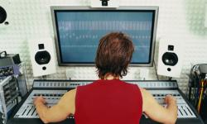
Types of Computer
Workstation
Desktop computer with more processing power
More memory
More capabilities in performing specialized tasks

Slide 32
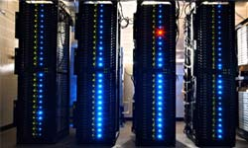
Types of Computer
Server
Computer that serves other computers over network
More processing power, memory and storage
Large in size

Slide 33
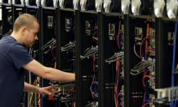
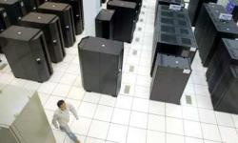
Types of Computer
Mainframe
Very large size
Now known as enterprise server
More processing power
Supercomputer
Very expensive
Fastest computers
Employed for specific applications which require immense amount of calculations
weather forecasting
scientific simulations
(animated) graphics
nuclear energy research
electronic design

Slide 34
Advantages of Computer
High Speed
Units of speed in microsecond and nanosecond
It can perform millions of calculations in few seconds where it will take months for a human to perform same calculations
Accuracy
100 % error free
Storage
More storage capacity than humans
All types of images can be stored

Slide 35
Advantages of Computer
Diligence
Free from tiredness and lack of concentration
Can work continuously without error and boredom
Repeated task with same time and accuracy
Versatility
solves different problems
Solving complex problems
Games
Reliability
Machines with long lives
Easy maintenance

Slide 36
Advantages of Computer
Automation
Computer is automatic machine
After taking input and program, then it can process without human interaction
Reduction in manual work and paper cost
Data stored inside computers electronically reduces paper cost
Increases speed
Data retrieved easily and speedily when required

Slide 37
Weaknesses of Computer
No I.Q.
No intelligence
Instructions given to computer
Cannot take decisions
Dependency
Depends on instructions given by humans
No Feeling
Cannot make judgment on feelings, taste, experience, knowledge
Notes:
Intelligence quotient

Slide 38
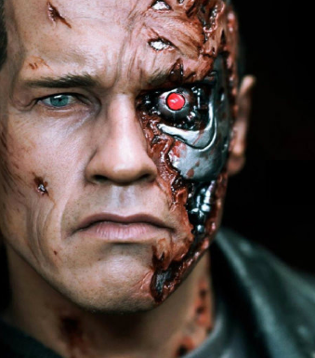

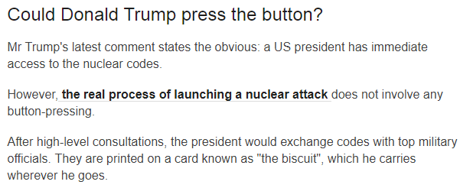
Cons
High risk of privacy invasion
Health implications
Social Disconnect
Addiction
But we have a choice:
What to do about/with this beast (Computer)?
http://www.bbc.com/news/world-asia-42549687
Notes:
But we have a choice.

Slide 39
End of The Lecture

